Slide 1

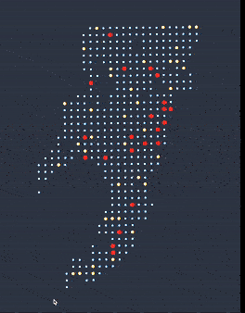
Facility Location Problem Using Genetic Algorithm
By Team Sigmas
Kavin R V Shashank Singh Yash Saxena

Slide 2
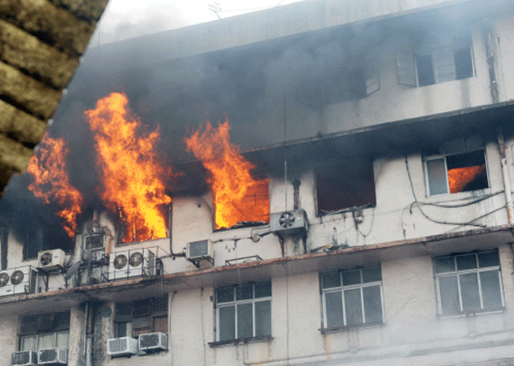
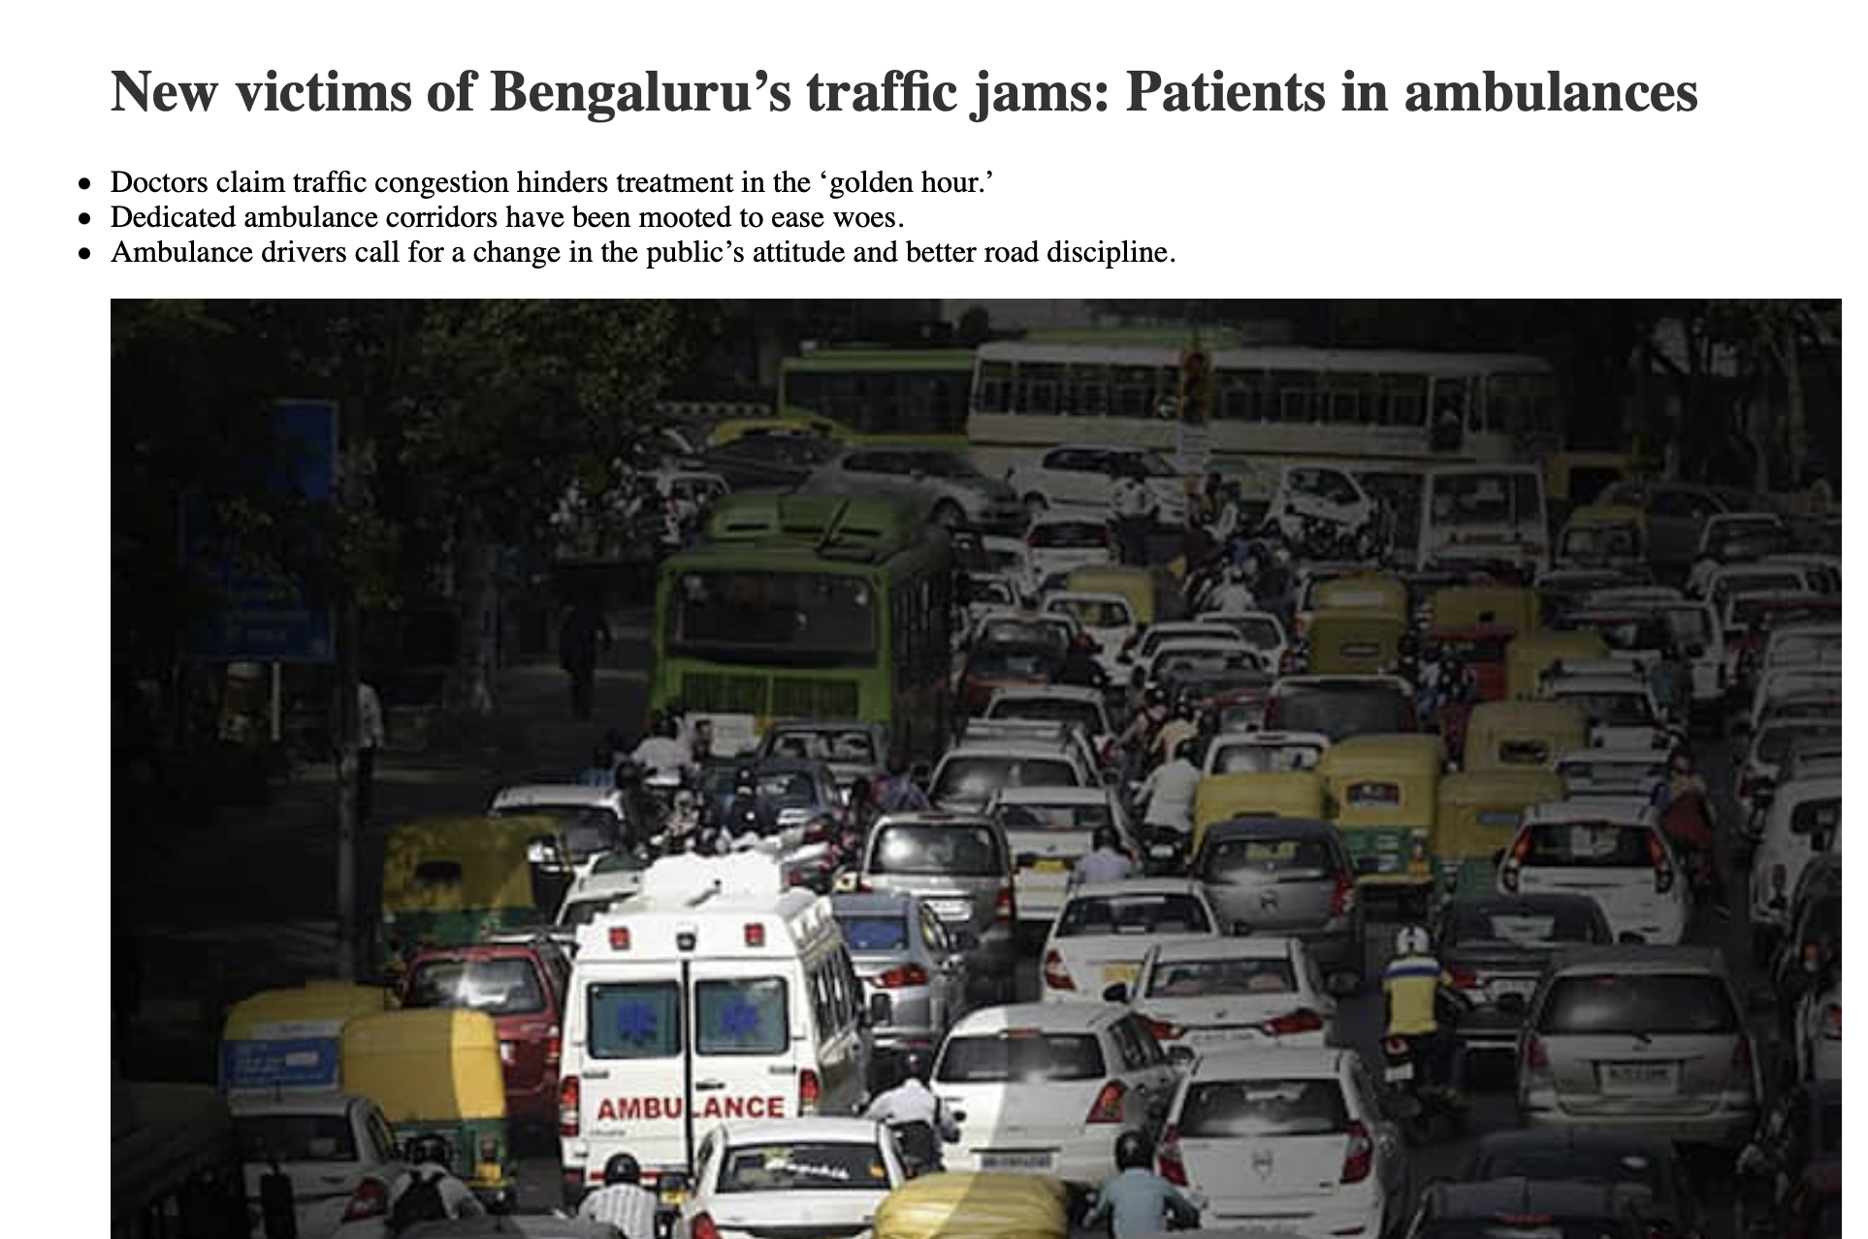
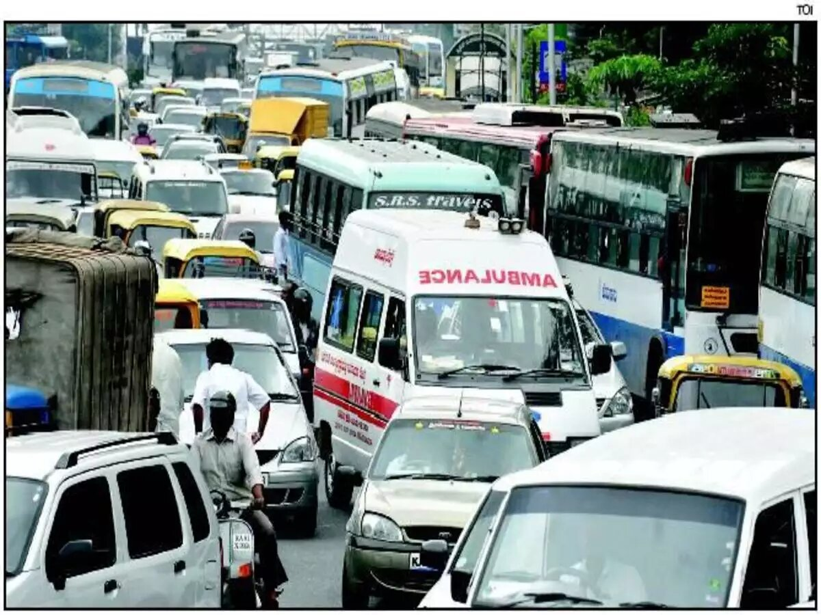
Motivation
Mumbai Fire
Fire, medical and other such emergency issues.
Ambulance Delay

Slide 3
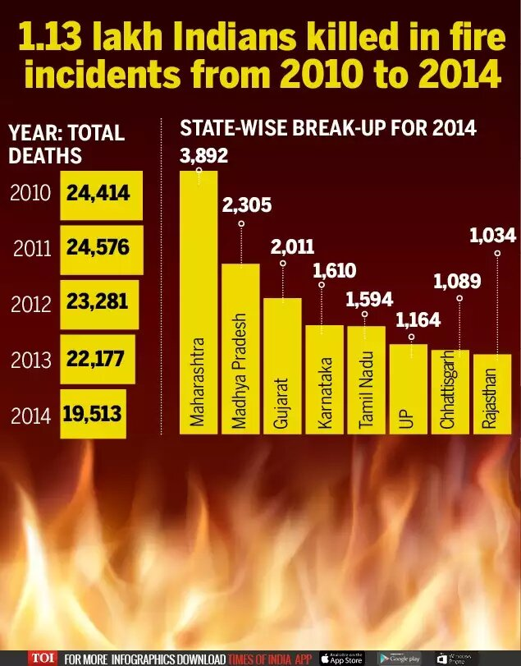
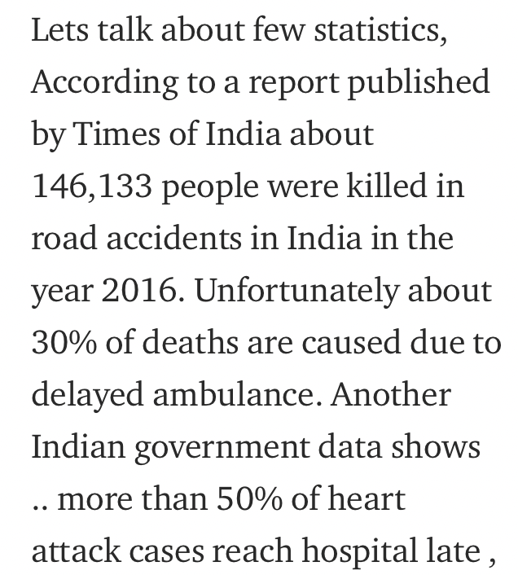
Emergency vehicle stuck in the traffic….scary?
Emergency vehicle stuck in the traffic….scary?
Emergency vehicle stuck in the traffic….scary?
Not enough ambulances...problem?
Sufficient ambulances and firetrucks available but not properly distributed….should we care?

Slide 4
Research Gap
Optimisation techniques have been used in past. Like Deterministic facility location problems, Minisum facility location problem etc.
Most researches are either very static in nature or are not able to cover all the constraints properly.
Need for an approach that is dynamic in nature, provides near optimal solution while covering most of the constraints.

Slide 5
Data Set The data file contains the following four datasets
Demand
Contains information about the rescue vehicles requirements of various points across three different time intervals.
Potential locations
Data regarding various points that can be a potential location.
Shapefiles
Plotting this data using a 3D visualization tool or some computational geometry method gives an idea of the location and how the points are distributed over a map.
Traveltime
Information containing the time required to travel from one location to the other in a matrix form. Where i,j stands for i as the demand point and j as the potential location.

Slide 6
Data Extraction
Normalised the time.
Normalised coordinate data to plot in canvas.
For demand: Location, Potential(Y/N), Vehicle list
For potential: Location, Fixed(Y/N), Density
Removed unwanted and erroneous data.
Crossover

Slide 7
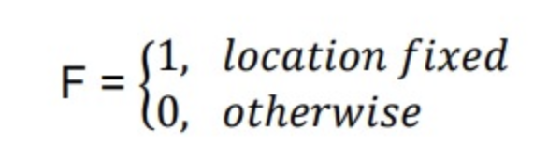
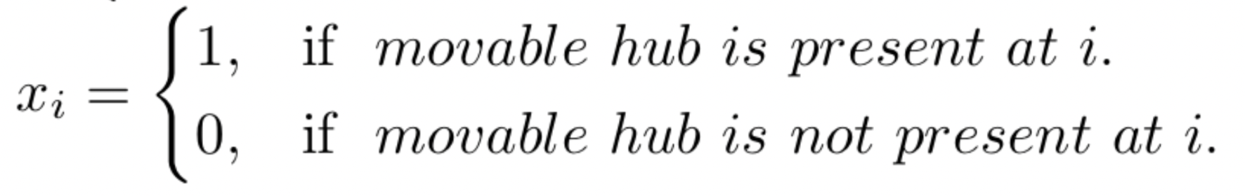
Maths involved
Apply Genetic algorithm to fixed location F fixed. To find other movable hubs.
The variable xi will represent whether a point has a hub or not such that.

Slide 8
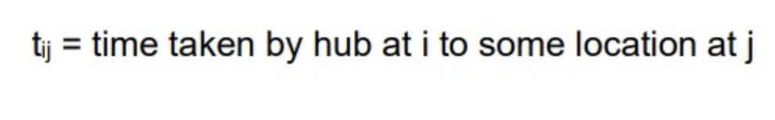
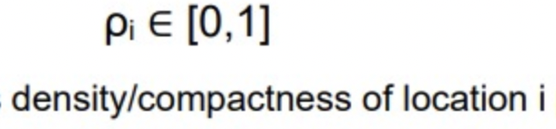
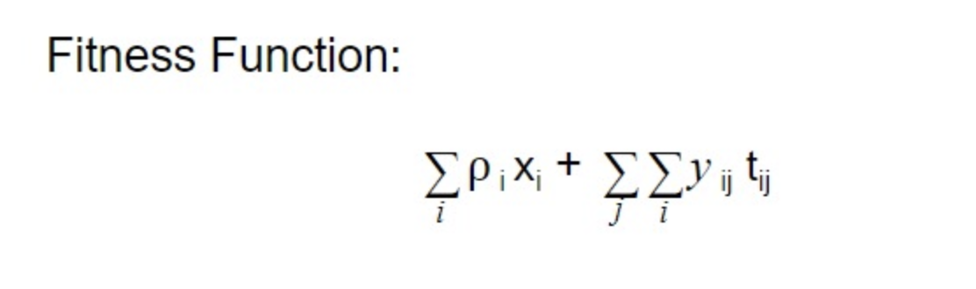
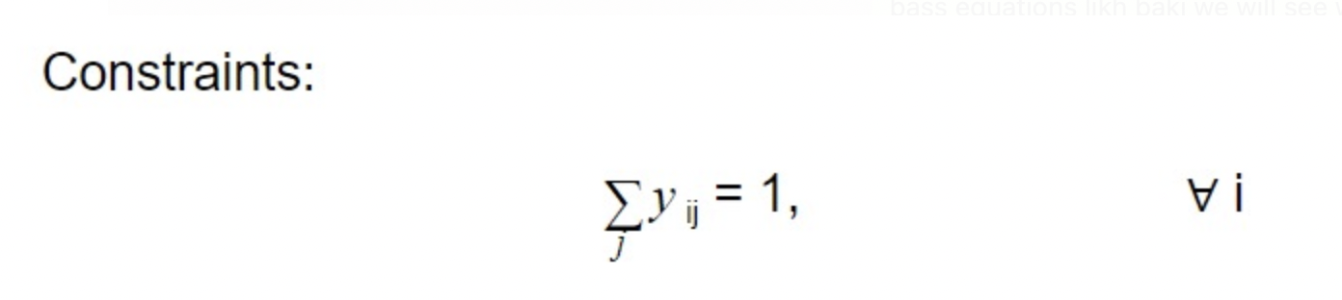

Slide 9
Genetic Algorithm
Inspiration from Darwinian natural selections
Inheritance
Mutation
Selection
Crossover
Crossover

Slide 10
Kavin R V
____________
Initialisation
Randomly selecting the population. In particular for this problem randomly choosing the desired location for fire station facility
Start
____________
Crossover
Parent 1
Parent 2
Initialize a Population
Child 1
Child 2
____________
Fitness
Probability of selection
F(x) = Function(Demand, Compactness, Distance, Coverage, Population)
Evaluation for section (Fitness Function)
____________
Other Types
Parent 1
Parent 2
Selection
Child 1
Child 2
____________
Mutation
Alternate
Crossover/ Mutation
P <= 1% (Based on problem size)
Parent 1
Parent 2
Mutation generates variation causing an evolution. Mutation chance should be low so it doesn’t cause too much variation
Is termination satisfied
No
Child 1
Child 2
Random
Yes
End

Slide 11
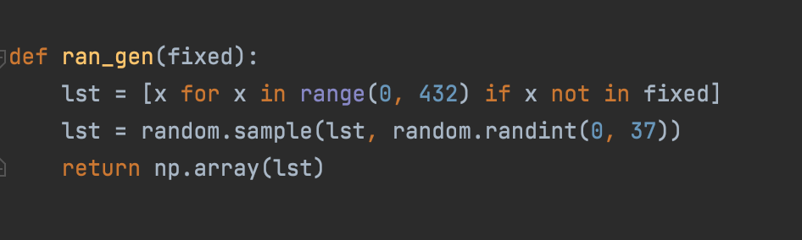
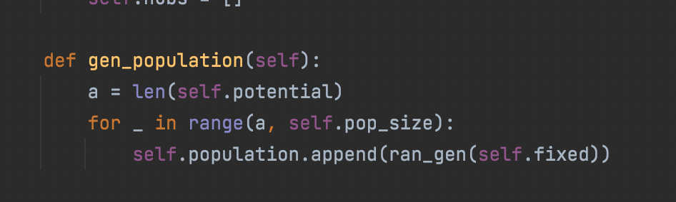
Kavin R V
____________
Initialisation
Randomly selecting the population. In particular for this problem randomly choosing the desired location for fire station facility
____________
Each Values are index of the potential location
432 32 112 23 11 7
____________
For the Data each gene is of length ranges from 0 - 37 denoting potential hub’s location index
____________
The total population is of size 1000 containing such random
Sized lists.

Slide 12
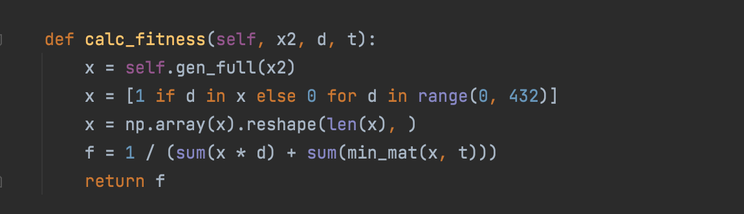
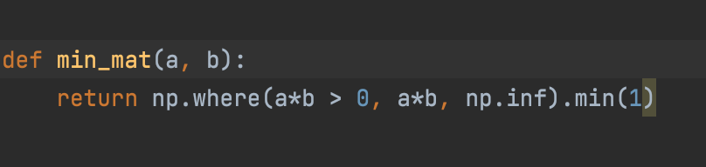
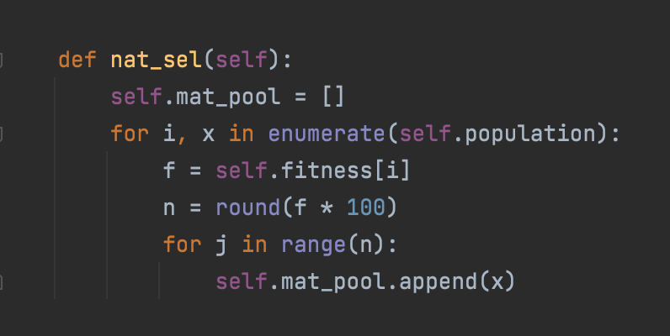
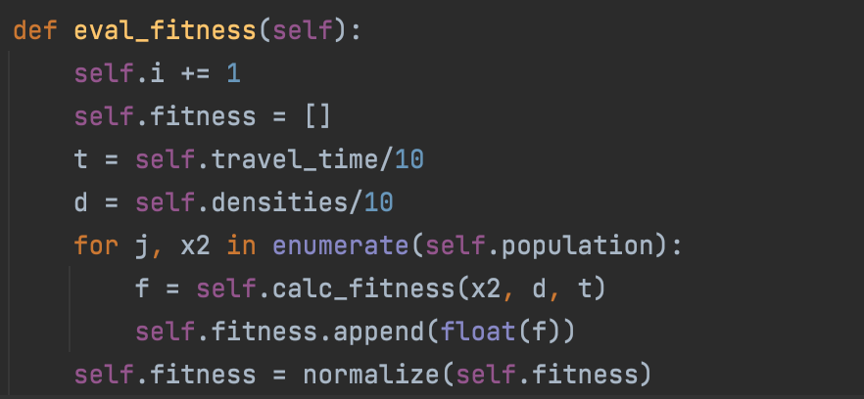
Kavin R V
____________
Objective Function
Sum (X[j]*d[j] + Y[i, j] + T[i, j])
For all i and j
____________
Fitness
objective function is that we have to minimize here. The fitness is the inverse of this function.
____________
X[j] → 1 if hub is placed at j th potential point, 0 otherwise
D[j] → Normalised density of the j th potential point
Y[i, j] → 1 if j th hub serves i th demand point.
T[i, j] → Normalised travel time from j th point to i th.
____________
Selection
Probability of selection
Is determined by fitness.
Higher the fitness more times a chromosomes is added to the mating pool.
____________
Sum over j(Y[i, j]) = 1 for all i
Each demand point should be served only by the nearest hub
Min_mat function takes care of it

Slide 13
Fitness Variables
432 element vector of compactness corresponding to potential at the respective index.
d
432 element vector with ones and zeros. Add to utmost around 60
X
464*432 travel time matrix that is normalized b/w 0 and 1
t
Finds the times for the nearest hub to a demand location and add times to a vector to add later basically same as the second part of the objective function.
min_mat

Slide 14
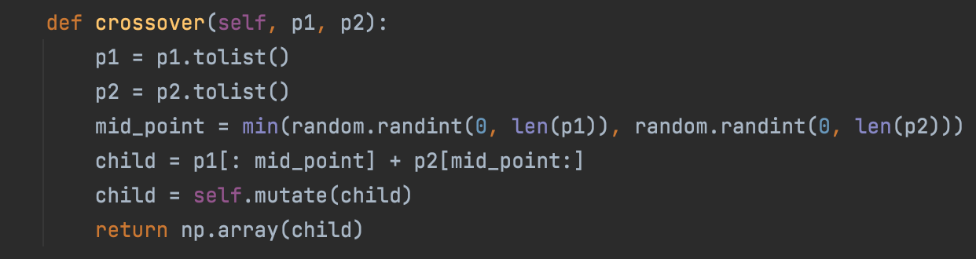
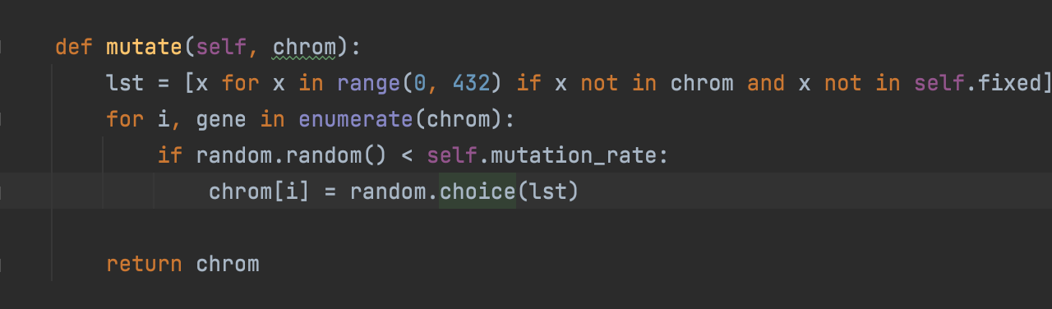
Kavin R V
____________
Crossover
Parent 1:
Parent 1
Parent 2
Parent 2:
Child 1
Child 2
Child:
____________
Midpoint is chosen randomly and New child is formed.
____________
Mutation
Each gene in the chosen to be mutated with probability of 1%. After the mutation the child replace a member in the population.
P <= 1% (Based on problem size)

Slide 15
Results And Discussion
In a population size of 1000, we have
Looped through our model and stopped it at desired loop
Achieved average population fitness of 0.52
Achieved best fitness value of 0.7 -----> objective function value = 10/0.7 (approx)

Slide 16
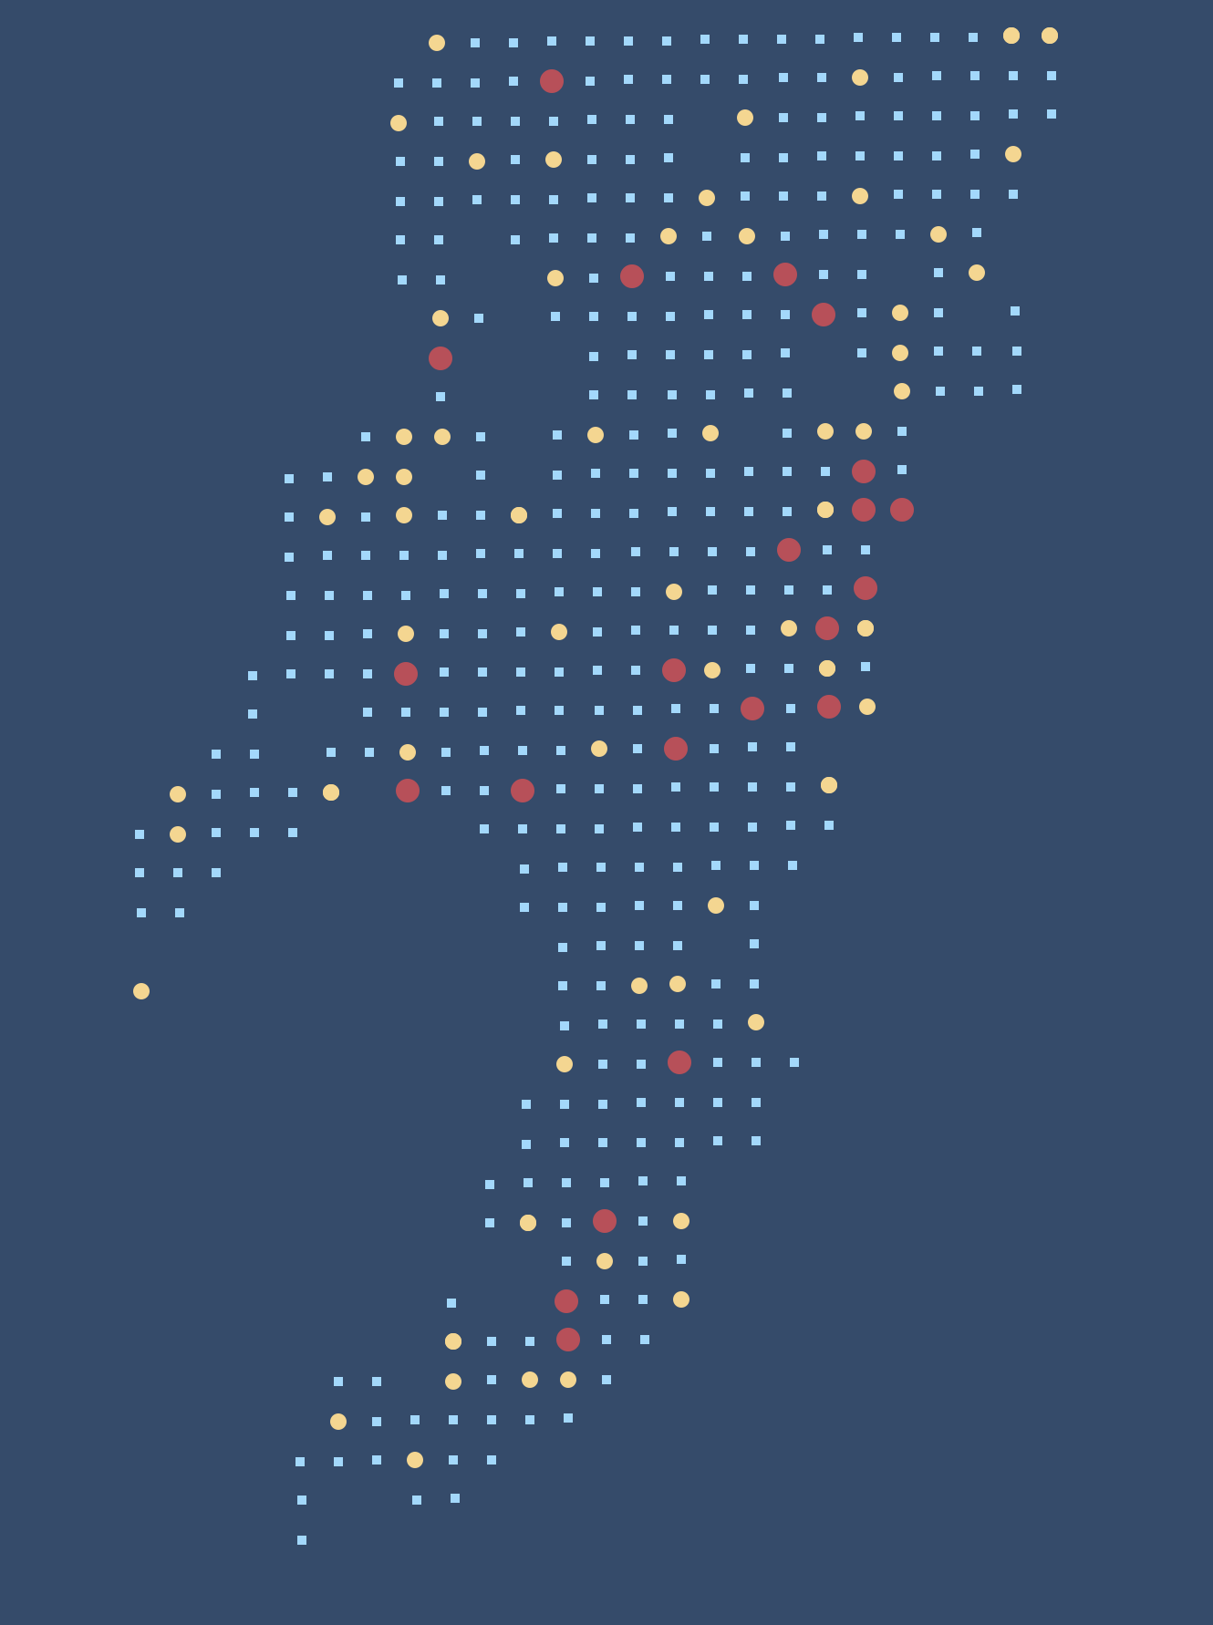
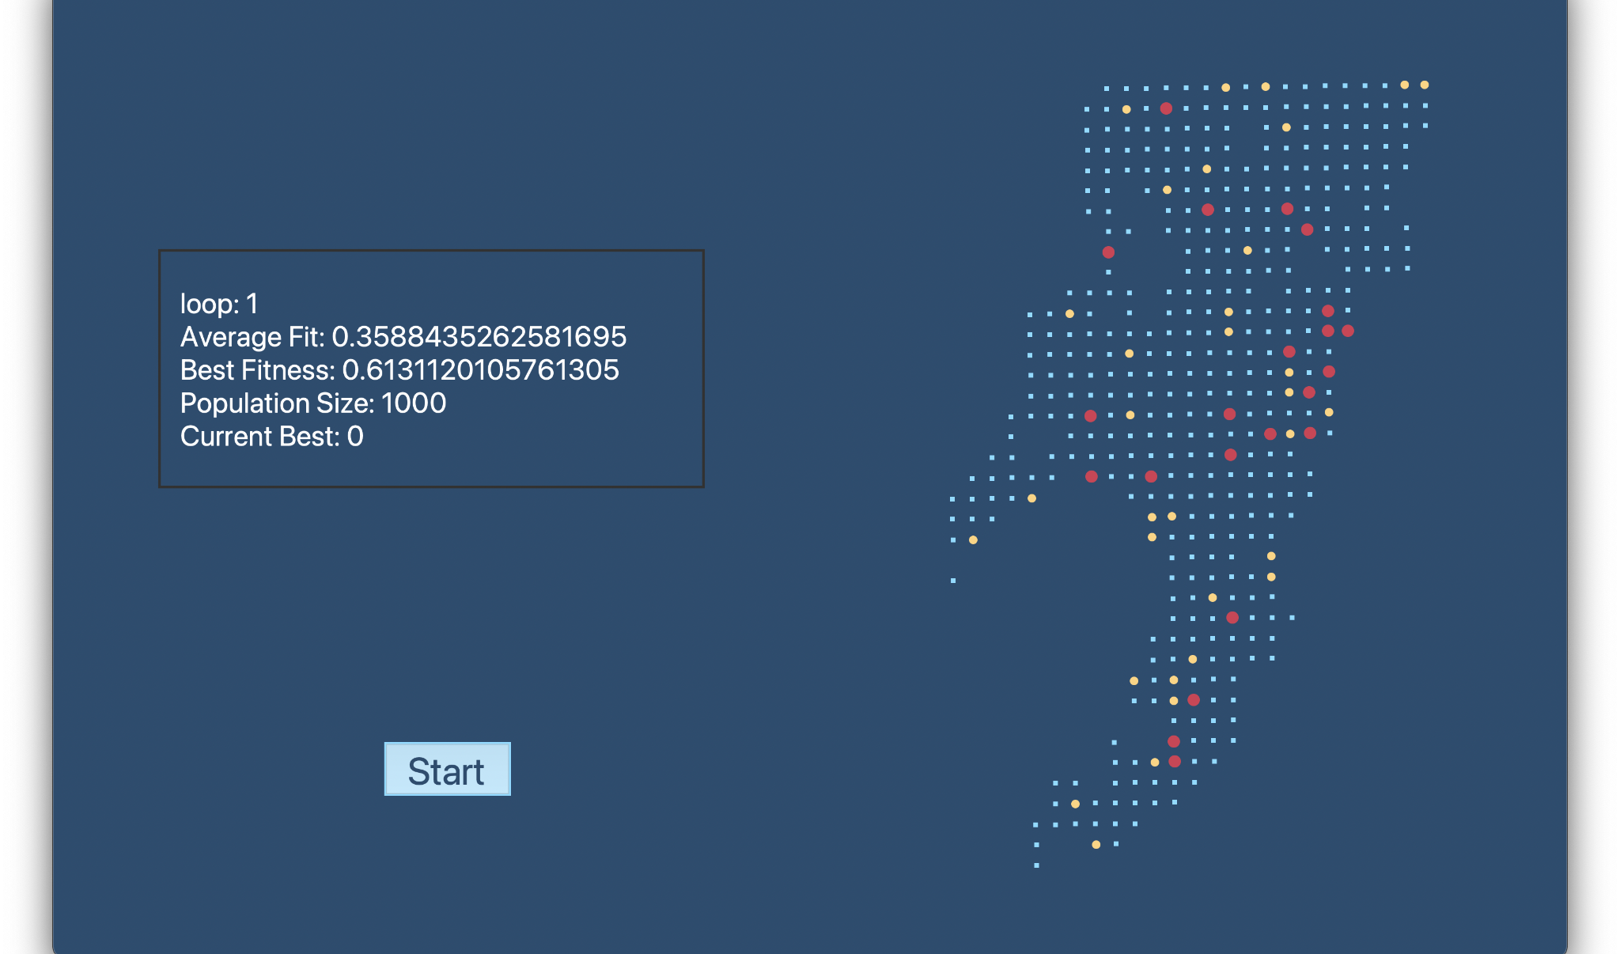
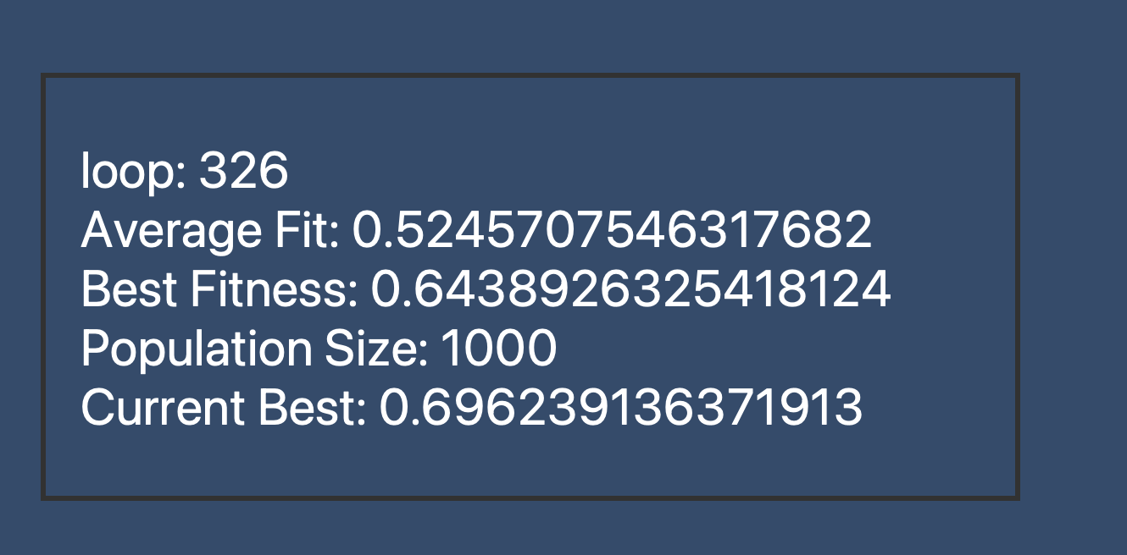
Fixed Location (Physical Fire stations)
Dynamic Hubs (Movable Fire stations hubs)
Potential Locations
Kavin R V
Kavin R V

Slide 17
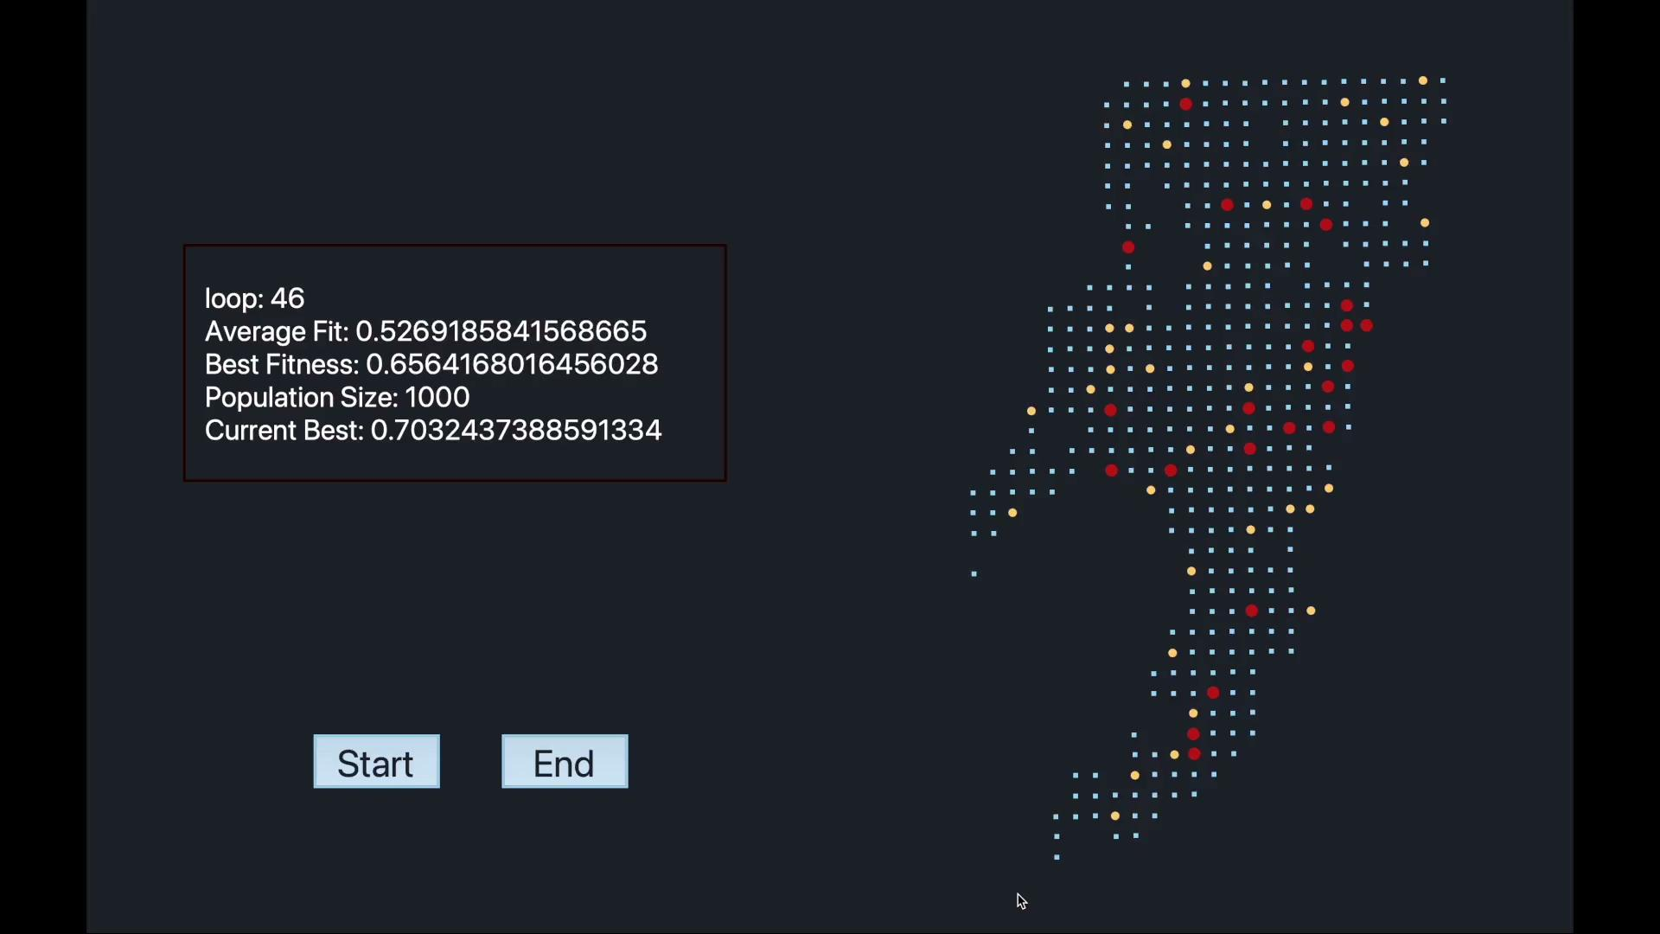
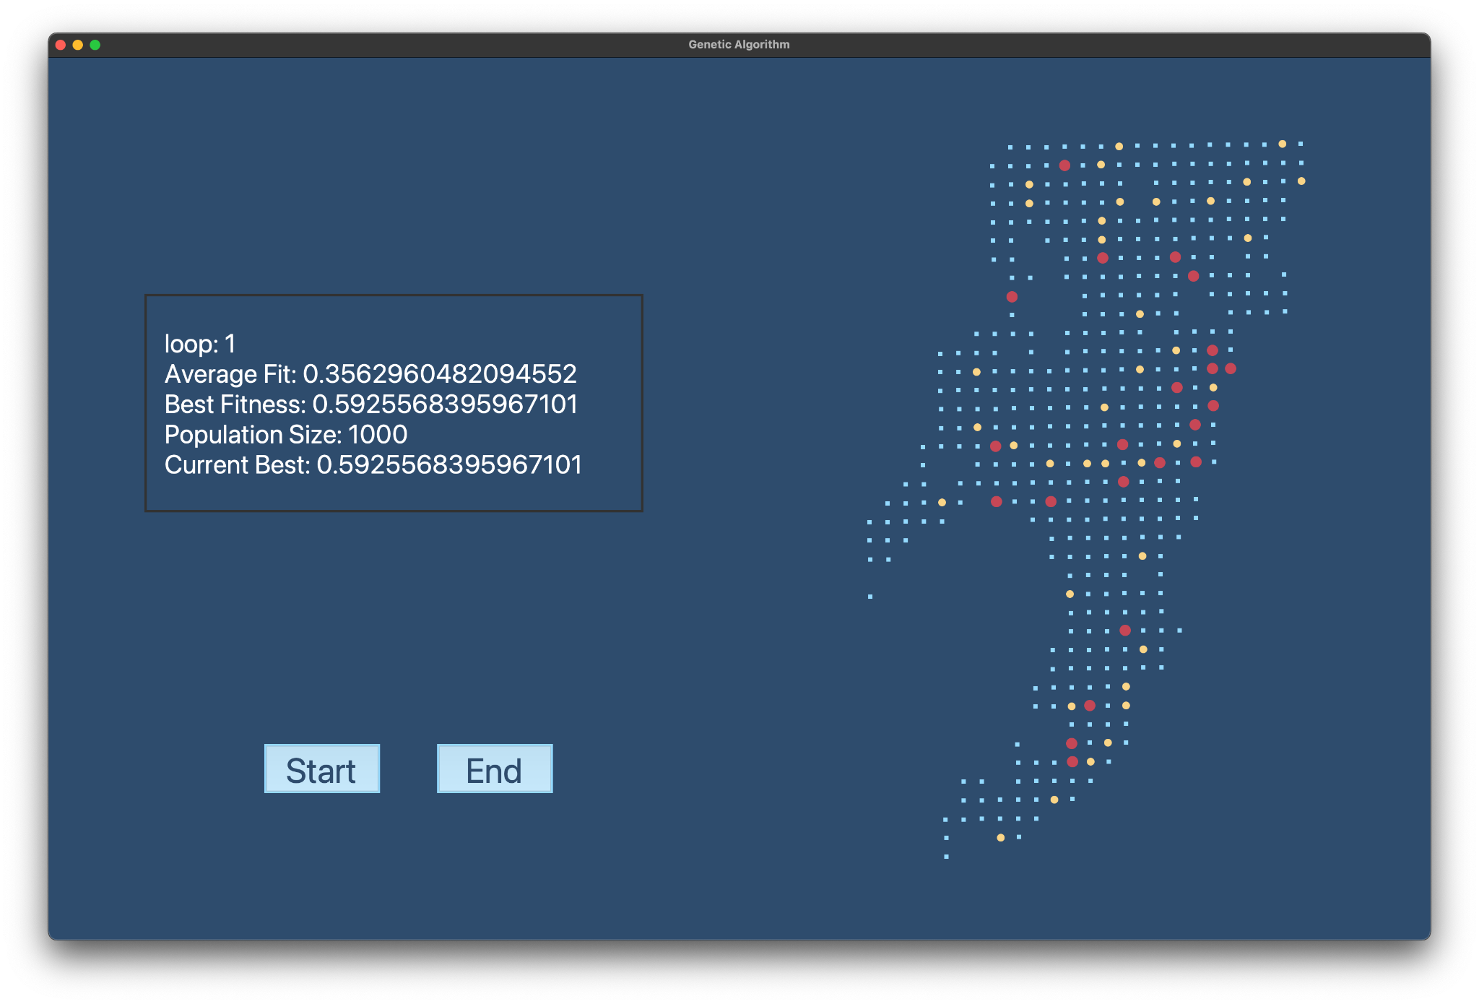
This is how our dashboard looks like.
It is a speed up version of our execution.
Kavin R V
In this particular case we were able to get a very good fit which not possible often as you can see in the other images.
Kavin R V

Slide 18
Conclusion
We have been able to find out potential locations, assign dynamic hubs for each and were able to visualise which fixed location will serve them.
The allocation is such that the hub may serve multiple demand points but each demand point is served only by a single hub.

Slide 19
Further Works
Acknowledgement
Each index denote a particular type of vehicle. And the value denotes the quantity of vehicle assigned to each hub
Complexity of each genetic cycle is very high. We could try to improve it make better to improve the speed of the program.
[1, 5, 3, 1]
Aloting no of vehicle that an hub can get from a particular station near that hub such that it could satisfy the demand of each points.
Can find better value to normalize the fitness. Cause it would give us better results
We could also try to build it under additional constraints of vehicle availability.

Slide 20
Acknowledgement
I Mihajlovic , Z Zivkovic, N Strbac, D Zivkovic, A Jovanovic, “Using Genetic Algorithms To Resolve Facility Layout Problem”, Serbian Journal of Management 2 (1) (2007) 35 - 46
Chawis Boonmee, Mikiharu Arimura, Takumi Asada, “Facility location optimization model for emergency humanitarian logistics”, International Journal of Disaster Risk Reduction
Introduction To Genetic Algorithms
Dr. Vaibhav Kumar for Dataset and Advices

Slide 21
Suggestions please.

